Slide 1
Deputy Head (Pastoral) Update
Monday 2nd September 2024

Slide 2
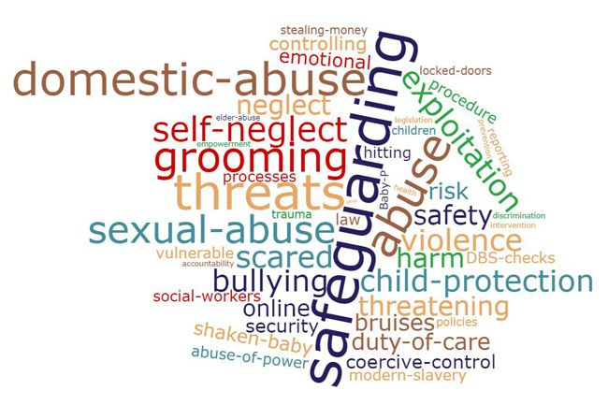
Agenda
KCSIE Sept 24 – changes and updates
Filtering and monitoring changes
Safeguarding – signs of abuse
Pupil supervision
Managing disclosures
Low level concerns and staff code of conduct
Visitors and visiting speakers
Minority groups and protected characteristics
Signing in and badging on site
Policy updates (SS behaviour, rewards and sanctions in particular)

Slide 3
KCSIE Sept 24 – changes and updates
Keeping Children Safe in Education 2024 does not contain major systemic changes – these have been deferred to next year and the Government began a call for evidence on safeguarding in schools and colleges which closed on 20th June 2024.
Ministers decided this year’s guidance should contain only “technical changes … with a view to providing a more substantively updated document, encompassing wider changes, to be delivered in 2025”.

Slide 4
Reminder of recent KCSIE changes
Updates made to KCSIE 2022 included:
incorporating the DfE’s advice on sexual violence and sexual harassment between children in schools and colleges
setting out the safeguarding implications for schools of human rights and equality legislation
providing more information on managing low level concerns
reinforcing the importance of talking to parents about children’s access to online sites when away from school.

Slide 5
Reminder of recent KCSIE changes
Updates made to KCSIE 2023 included:
clarification around the roles and responsibilities of education staff in relation to filtering and monitoring
clarification that being absent, as well as missing, from education can be warning sign of a range of safeguarding concerns, including sexual abuse, sexual exploitation or child criminal exploitation
additional information on online pre-recruitment checks for shortlisted candidates
information on responding to allegations related to organisations or individuals using school premises.

Slide 6
Changes for September 2024
In line with the Working Together to Safeguard children 2023 guidance. Safeguarding and promoting the welfare of children is now defined as…
Providing help and support to meet the needs of children as soon as problems emerge (this bullet point is new)
Protecting children from maltreatment, whether that is within or outside the home, including online (this last part has been added)
Preventing the impairment of children’s mental and physical health or development
Making sure that children grow up in circumstances consistent with the provision of safe and effective care
Taking action to enable all children to have the best outcomes

Slide 7
Changes for September 2024
Triggers for Early Help now also include;
Missing from education (CME) as well as from home/care
Experiencing multiple suspensions and/or being at risk of permanent exclusion (reminder duty to safeguard all pupils no matter what the circumstances)

Slide 8
Pupil Supervision
If you see or hear something that doesn’t look right…
More later

Slide 9
Filtering and monitoring changes at Claremont
From Securus to Smoothwall. An extract from the safeguarding policy…
In terms of filtering, the school utilises a firewall service (Smoothwall) to filter content and thus ensure that all pupils and staff using the Claremont Wi-Fi are prevented from being able to access or receive material that is not suitable for a place of education and/or work. It should be noted that if off site (for example on home Wi-Fi), devices issued by Claremont continue to be filtered and monitored, but 'bring your own devices’ (BYOD), are not filtered by the school and it is the responsibility of parents to ensure they have sufficient safeguards in place.
In monitoring terms, Claremont also uses the Smoothwall platform to ensure that pupil devices in Years 3-11 are monitored 24/7 (including when off-site) for any inappropriate and/or concerning use of language and/or attempts to access content which is inappropriate (balanced alongside access for educational need).
Smoothwall monitoring and safeguarding software triage alerts according to their severity, which includes an email alert service and a phone call to the DSL for ‘L5’.
For 6th form pupils who use their own computers under the BYOD scheme, their use of websites is not monitored at home or school (although on the site, our firewall will block content deemed as inappropriate).
Claremont also makes use of Sophos as an Internet security software (like anti-virus) which blocks bad applications and this is monitored by the IT team, and the Applocker product to limit and control the installation of software - in particular software frequently used to subvert other security systems.

Slide 10
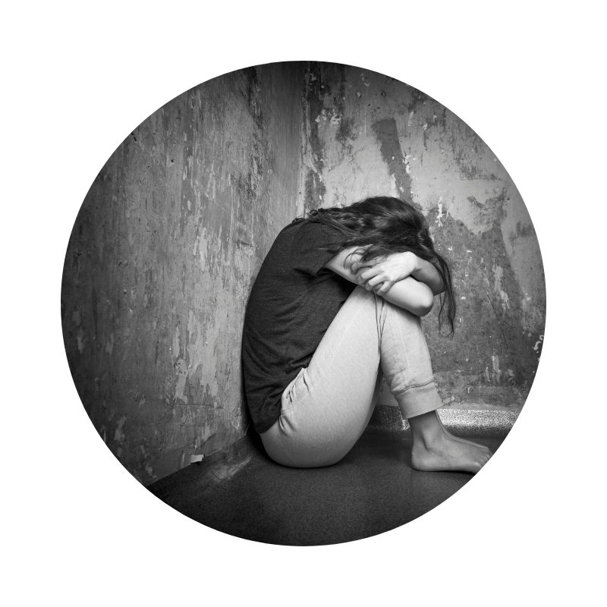
Abuse – types and signs
You all need to know that are multiple types of abuse. Physical, emotional, sexual and neglect.
People often think about this ‘being done’ by adults to children, in person, and involving adults who are not well known to the child.
However, we know that it is most likely within families, although still common within institutions and wider society, and can be facilitated entirely online.
There are multiple indicators for each type of abuse, but fundamentally, if you see or hear something that ‘doesn’t feel right’, you should speak to a DSL. This could be something obvious like a new bruise or a child suddenly becoming withdrawn.

Slide 11
Child on child abuse (formerly peer on peer abuse)
Children can and do abuse other children.
Child on child abuse is any form of physical, sexual, emotional and financial abuse, and coercive control, exercised between children and within children's relationships (both intimate and non-intimate).
Common examples include bullying (real world and/or online) and physical harm caused with intent.
At Claremont, we should adopt a ‘it does happen here’ and ‘zero tolerance’.

Slide 12
Managing a disclosure – best practice
Take what you are being told seriously.
Prioritise this moment and ask for support from colleagues nearby.
Listen carefully – do not interrupt or ask leading questions.
Acknowledge what you have been told and make notes if possible.
Remain calm, empathetic and understanding.
Reassure – tell them they have done the right thing.
Tell them you will have to pass the information on, who you will be telling and why.
Pass to your DSL in writing with dates and times (preferably via CPOMS, but also via email or phone if urgent/immediate).
Please note that the DSL should explain what they are going to do next (expect to be told that day) and if you are unhappy with the DSL response you must report your concerns directly to social services (make a referral)

Slide 13
Why children don’t report abuse
May not be listened to | Embarrassment | Adults not sympathetic
May not be believed | Unable to communicate the abuse | Adults might tell someone else
Fear of consequences | Not knowing who to tell | Understanding or recognising abuse
Lack of control | Previous/current experience of racism | Believe it is their own fault

Slide 14
Low Level Concerns (LLC)
JST as whole school/site DSL. All LLC’s to him for review, management and record keeping. JST works closely with the Heads and HV as lead DSL in the Junior School.
Reminder;
A LLC is any concern that an adult working at/with the school may have acted in a way that:
is inconsistent with the staff code of conduct, including inappropriate conduct outside of work; and
does not meet the allegations threshold or is otherwise not considered serious enough to consider a referral to the LADO If there is any doubt as to whether the information which has been shared about a member of staff as a low-level concern in fact meets the harm threshold, consult with the LADO.
A ‘low-level’ concern does not mean that it is insignificant.

Slide 15
For example...
Examples of such behaviour could include, but are not limited to:
being over friendly with children;
having favourites;
taking photographs of children on their mobile phone;
engaging with a child on a one-to-one basis in a secluded area or behind a closed door; or,
using inappropriate sexualised, intimidating or offensive language.

Slide 16
Sharing a low-level concern – the process
Report to the DSL, or in the case of concern about DSL, The Head.
Staff are encouraged and should feel confident to self-refer where, e.g., they have found themselves in a situation that might be misinterpreted, might appear compromising to others and/or reflection they feel they have behaved in a way which they consider falls below the expected professional standards.
Where a low-level concern related to a person employed by a supply agency or a contractor to work in the school, that concern should be shared with the DSL or Head, recorded and their employer notified of the concern
References – Low level concerns will not be included in references, unless they relate to issues which would normally be included in a reference e.g., poor performance or misconduct. It follows that a low-level concern which relates exclusively to safeguarding, would not be included in a reference. However, if the low-level concern meets the threshold for referral to LADO and is substantiated, it will be referred to in a reference.
See Low level concerns guidance within Safeguarding policy for more detail.

Slide 17
Senior school sanctions – an update
Name of sanction | When | Where | How long | Examples | Activity | Staffing
Supervision | Tuesday and Thursday lunchtime | Albany and Charlotte | 45mins | Breaking school rules e.g. persistent or significant breach of dress code, lack of homework and/or proper equipment despite warnings | School work, catch up if needed | DHOH
Community service | Wednesday 1.15pm | Mansion reception | 30mins | For low level damage to property and/or lack of respect shown to the school buildings and grounds | Site service | E&F team
Detention | Tuesday 4.15pm | Drawing Room | 45mins | Persistent breaches of school rules e.g. unkindness and rudeness, foul language, poor punctuality, failure to follow instructions, misuse of mobile phones | Reflection tasks or academic study (if appropriate) | HODs and TICs
Senior pastoral staff detention | Wednesday 4.15pm | Drawing Room | 1hr | Significant breach of school rules e.g. bullying, inappropriate language (e.g. sexist, racist, homophobic) towards staff and pupils, damage to property/vandalism | Reflection and/or extension tasks | HOH, HOY12 and HOSF
Saturday detention | Specific dates 9am-12 | Various | 3hrs | Sustained or extreme breach of school rules e.g. inappropriate behaviour, truancy (or) an accumulation of 4hrs+ of sanctions | School work and wider reading | SMT
Suspension | As required | DHP office or off site | 1-3 days | Vaping, sustained and/or dangerous behaviour, theft | Reflection task and/or discussion | Deputy Head (Pastoral)

Slide 18
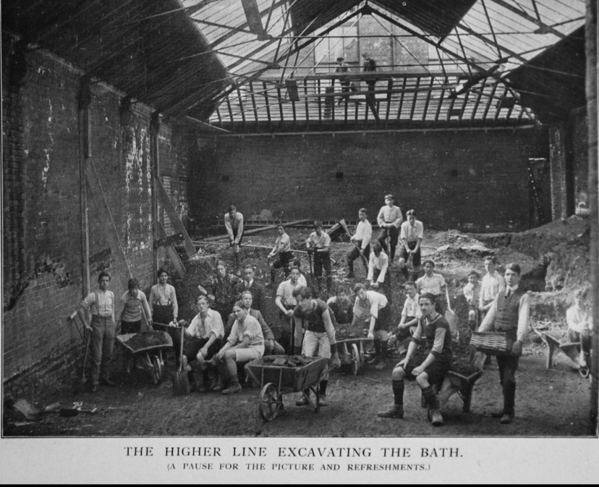

Slide 19
Final comments/reminders…
You will receive an email from HR today which asks you to complete a certain amount of reading of school policy and some basic confirmation exercises to provide evidence that you have read and understood these policies.
New staff or anyone with a new phone over the summer, please let Rachel Heard (RHE) know and she will help you to get or reset your CPOMS account. Rachel is available before school each morning this week in her office in The Warren. We will also send out a reminder sheet on how to link a phone to a CPOMS account.
Don’t forget that we are monitoring all staff laptops (as well as pupils) 24/7!
Please remember that all visitors to Claremont must sign in at one of the school receptions and be badged. We have a new system at each reception which includes photo ID. Anyone not properly badged and not picking up a child, must be challenged.
If you have a visiting speaker who will be talking to pupils, please follow the visiting speaker policy.

Slide 20
Thank you
Any questions
Claremont Drive, Esher, Surrey, KT10 9LY | www.claremontfancourt.co.uk | 01372 467841 |

